Slide 1



an innovative approach to inform equitable growth

Slide 2
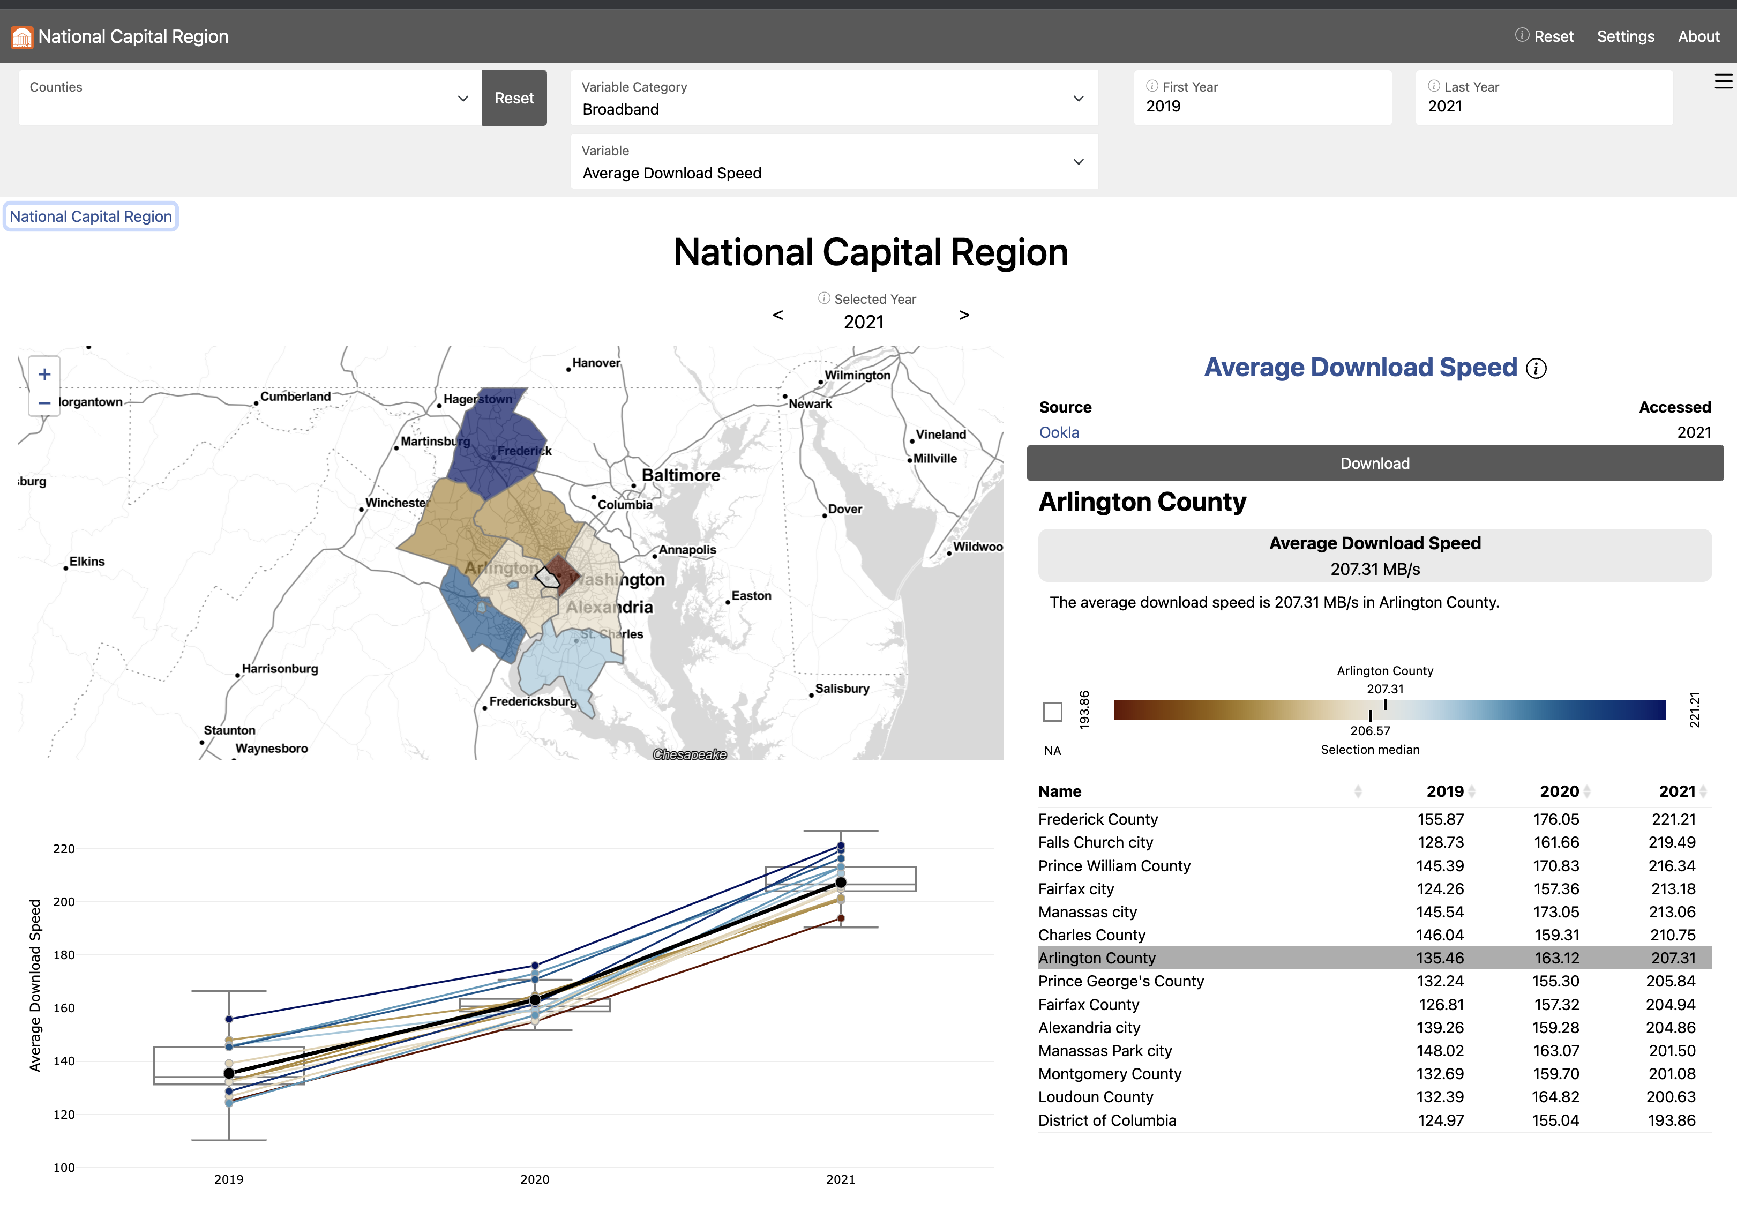
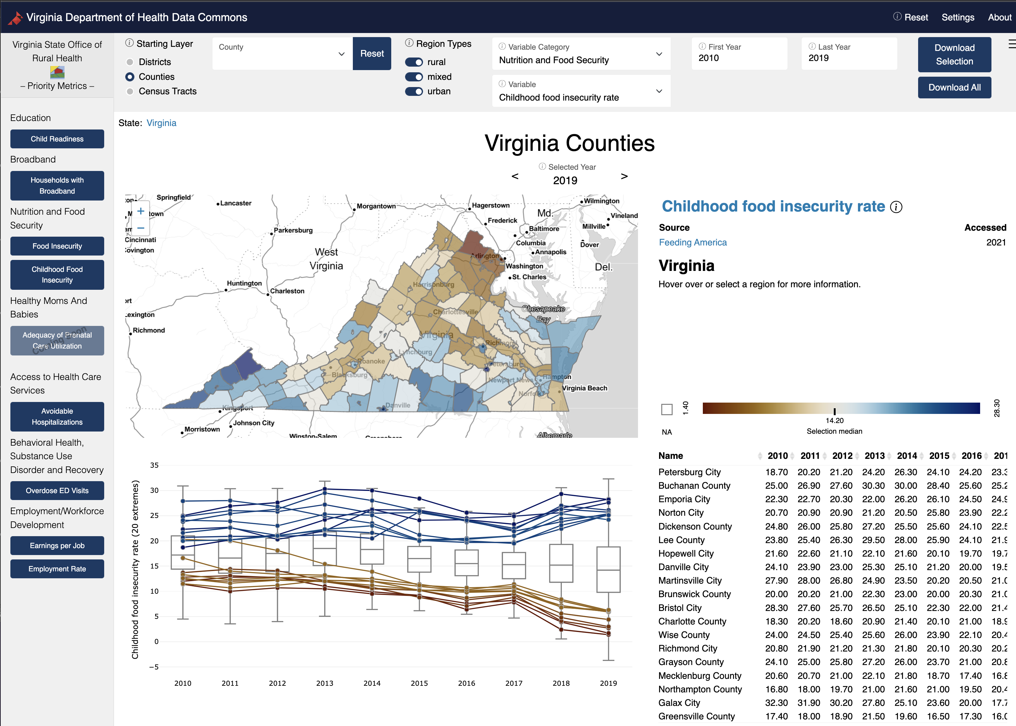
Two Data Commons Projects
1. Social Impact Data Commons to Inform Equitable Growth (Mastercard Center for Inclusive Growth) – National Capital Region
2. Data Commons to Support Department of Health Strategic Plans (Virginia Department of Health) – State of Virginia
Both applying the CLD Process to discover data needs
https://uva-bi-sdad.github.io/capital_region
https://uva-bi-sdad.github.io/vdh_rural_health_site

Slide 3
Me
Aaron Schroeder, PhD Research Associate Professor and Data Scientist, Social Decision Analytics Division (SDAD) of the UVA Biocomplexity Institute
Overarching research focus is the enablement of Evidence-Based Policy-Making and Program Evaluation through the Secure Liberation, Integration and Analysis of All Available Data
Background is Public Policy & Public Administration, long-term research focus on Data
Learned early-on that “good” policy and program-level decision-making relies on good data, but that many times the data was inaccessible, was unusable in its current state, or simply didn’t exist
Have spent much of my career trying to address these very issues
Creating the privacy-protected probabilistic linking mechanism to federate data between multiple state agencies for the Virginia Longitudinal Data System (VLDS)
Integrating all available traffic incident, construction, and travel data into a singular access point, 511 Virginia
Creating a data collection system, the Virginia Early Childhood Professional Registry, to collect policy-relevant credential data not previously collected
Lead our Research Infrastructure, Data & Development Team
Overall Responsibility for Software Development and the Scientific Computing Infrastructure at SDAD
Co-director of the Data Science for Public Good (DSPG) Young Scholars Program
immersive summer data science program for undergraduate and graduate students from across the country
Principal Investigator on many social-good-oriented data integration projects, including today’s focus project, the Social Impact Data Commons

Slide 4
SOCIAL IMPACT DATA COMMONS
Agenda
PROJECT VISION
PROJECT TIMELINE
PROJECT APPROACH
AN EXAMPLE – BROADBAND
OTHER EXAMPLES (VERY BRIEFLY)
ARCHITECTURE
NEXT STEPS & DISCUSSION!

Slide 5
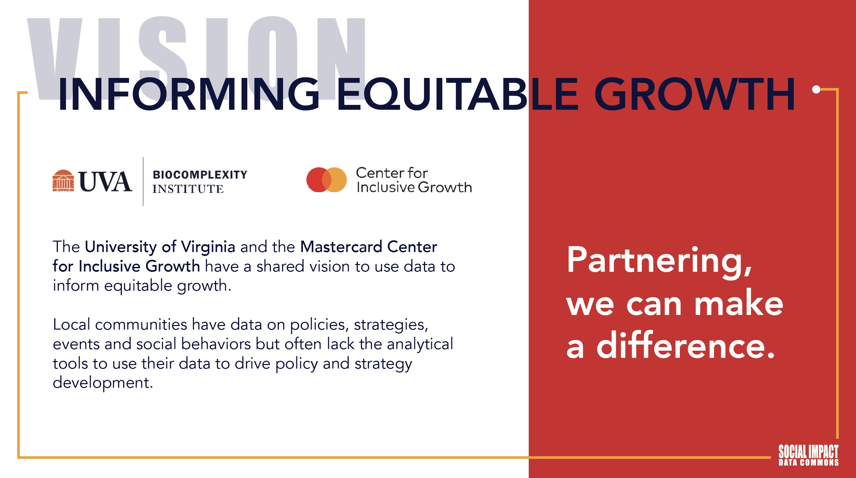

Slide 6
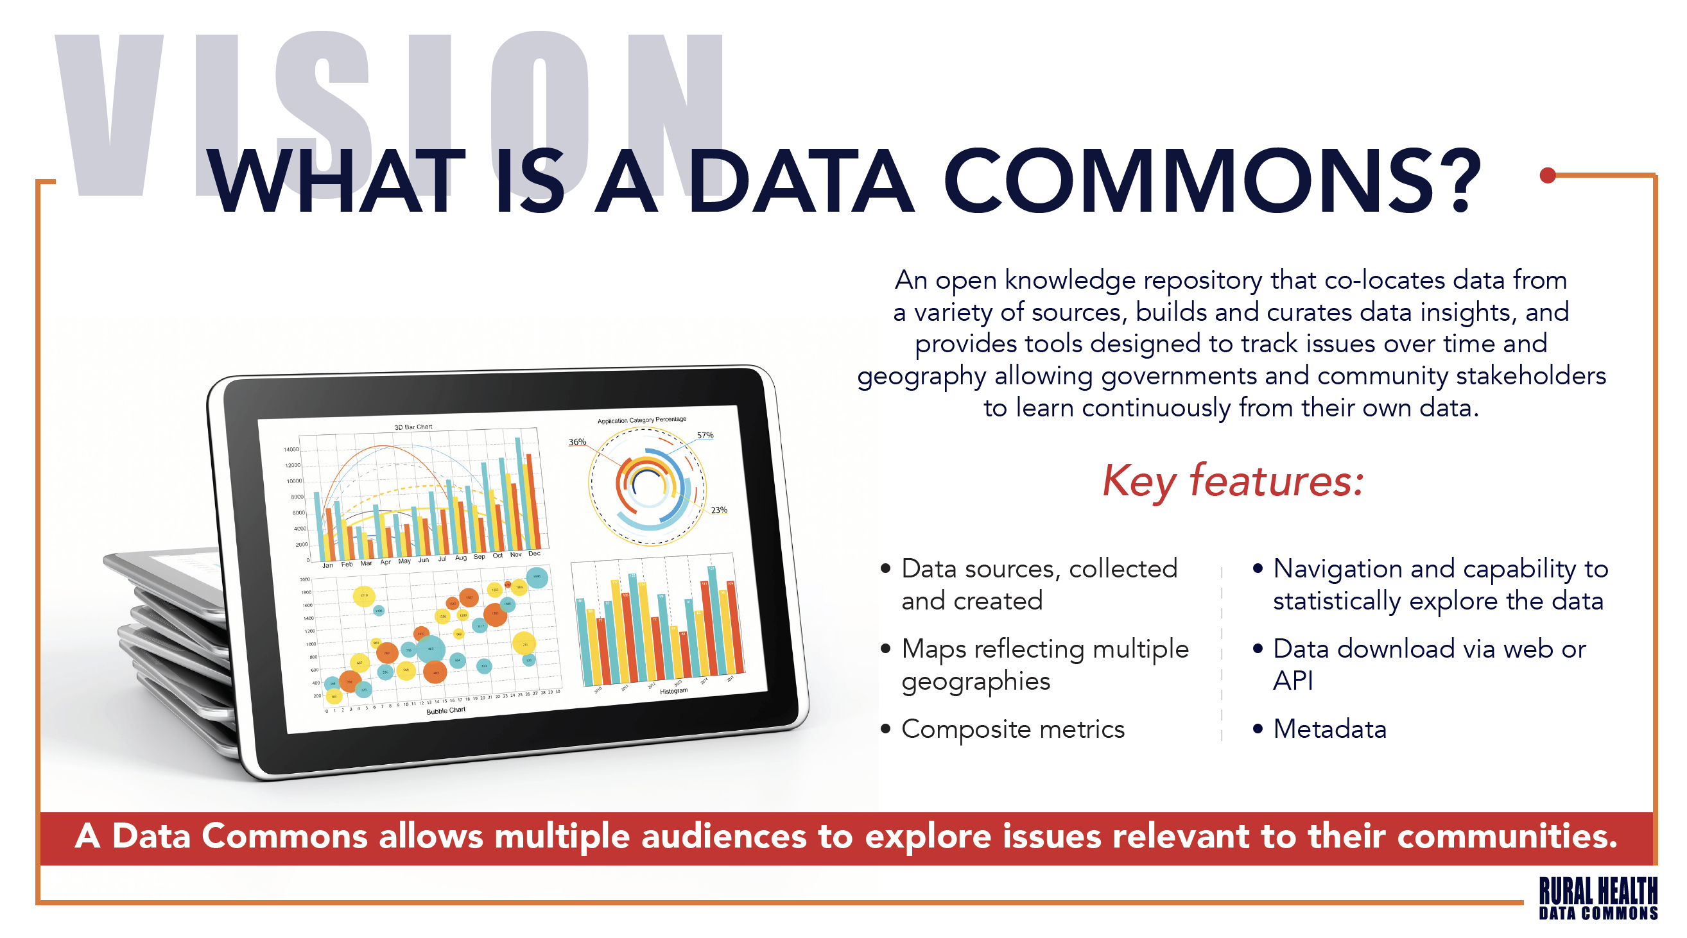

Slide 7
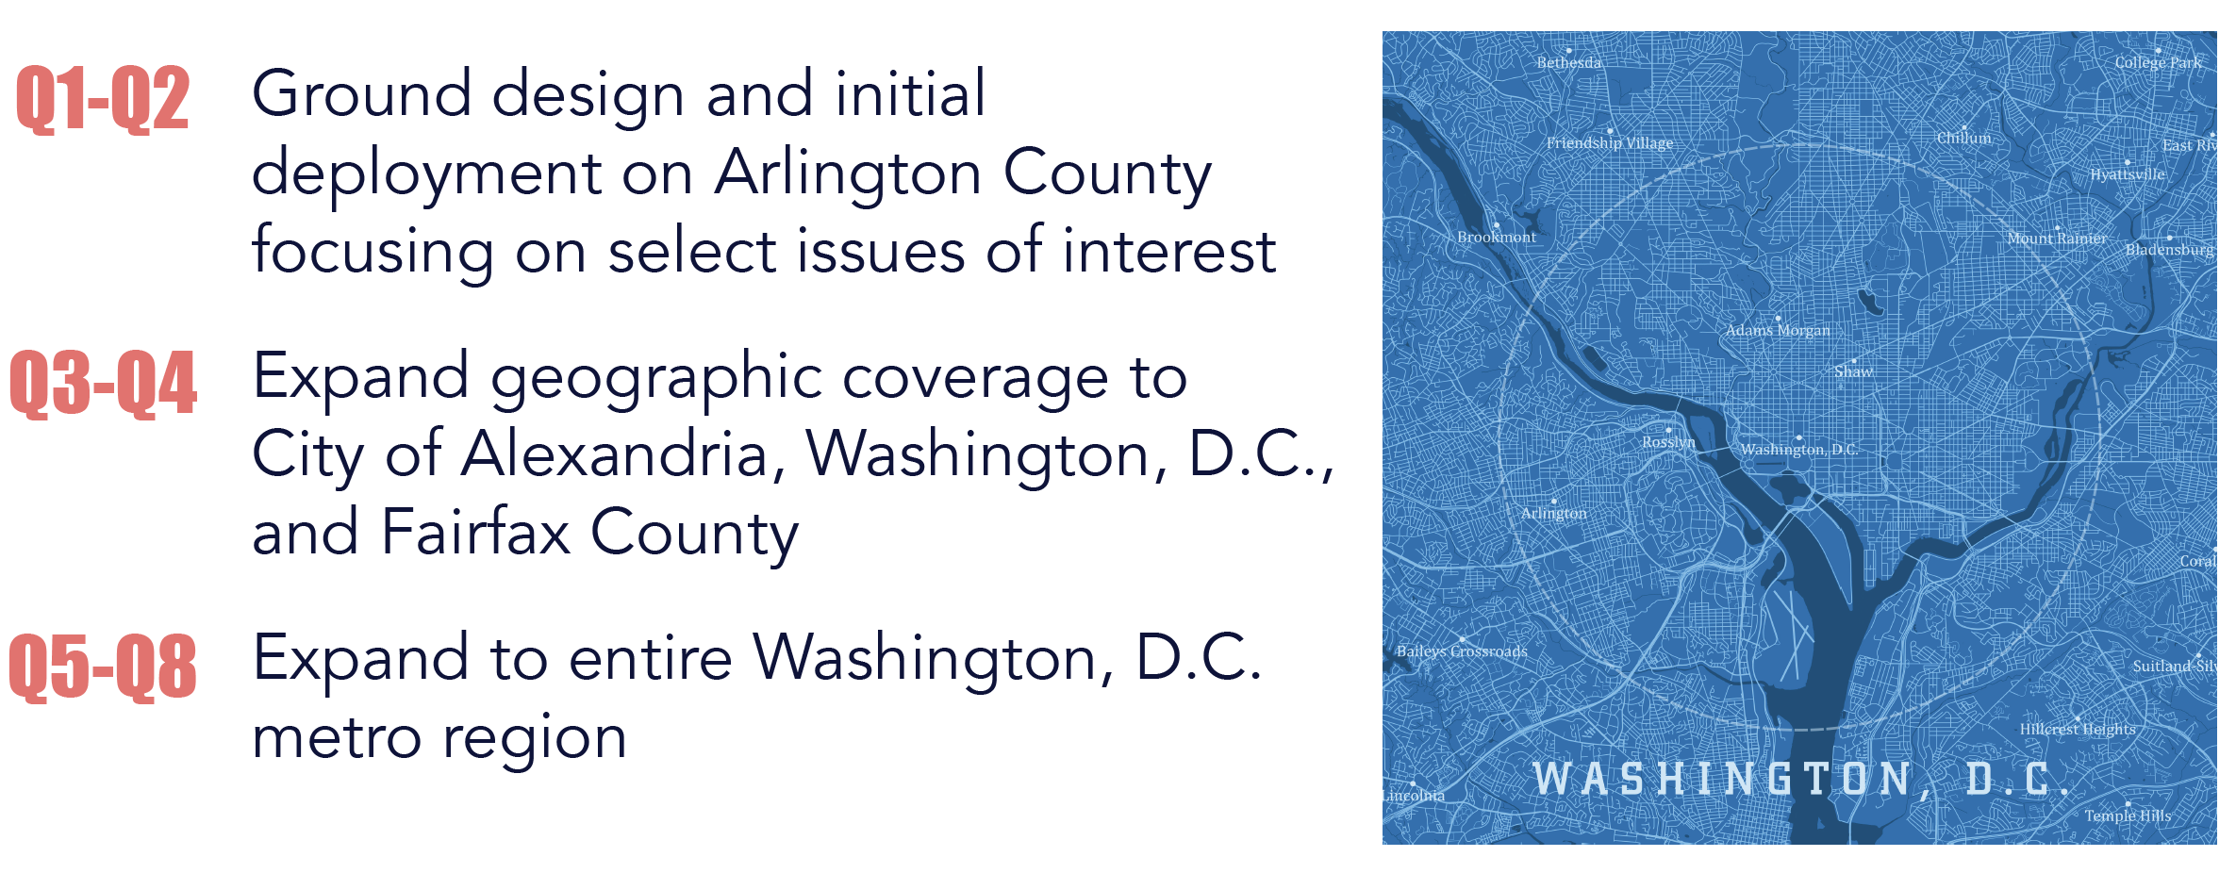
PROJECT TIMELINE
Project Phases MC

Slide 8
PROJECT APPROACH
Initial Grounding in Specific Local Issues
To kickoff the project, the team worked in partnership with Arlington County policymakers to identify several local social impact issues
These issues were selected on the basis that they can immediately benefit from the provision of new data and metrics and serve as powerful exemplars to showcase the impact and values of the Social Impact Data Commons as the project expands
Initial Issues:
Equity of Broadband Access
Equity and Stability of Access to Staple Foods
“Other-Than Census” Geographies for Equity Analysis

Slide 9
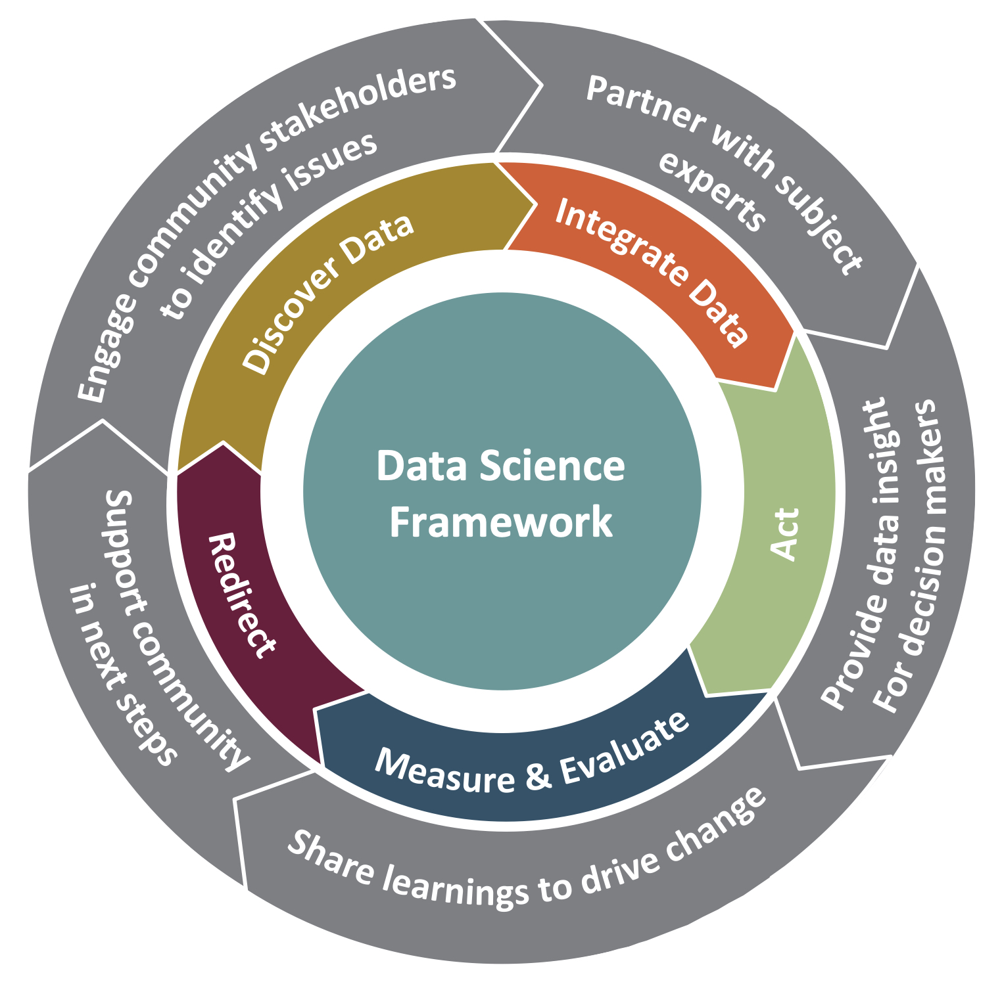
PROJECT APPROACH
Iterative Process with Decision Makers Getting to Required Data & Metrics
Community Learning Through Data Driven Discovery (CLD3)
CLD3 goes beyond traditional organizing aspects of collective action programs and supports communities in building capacity for data-informed decision making.
Outer wheel: continuous interaction and communication across stakeholders
Middle wheel: data-driven learning process
Frontier: between the outer and middle wheels is active collaboration between all partners
Inner circle: rigorous research framework to guide the data science

Slide 10
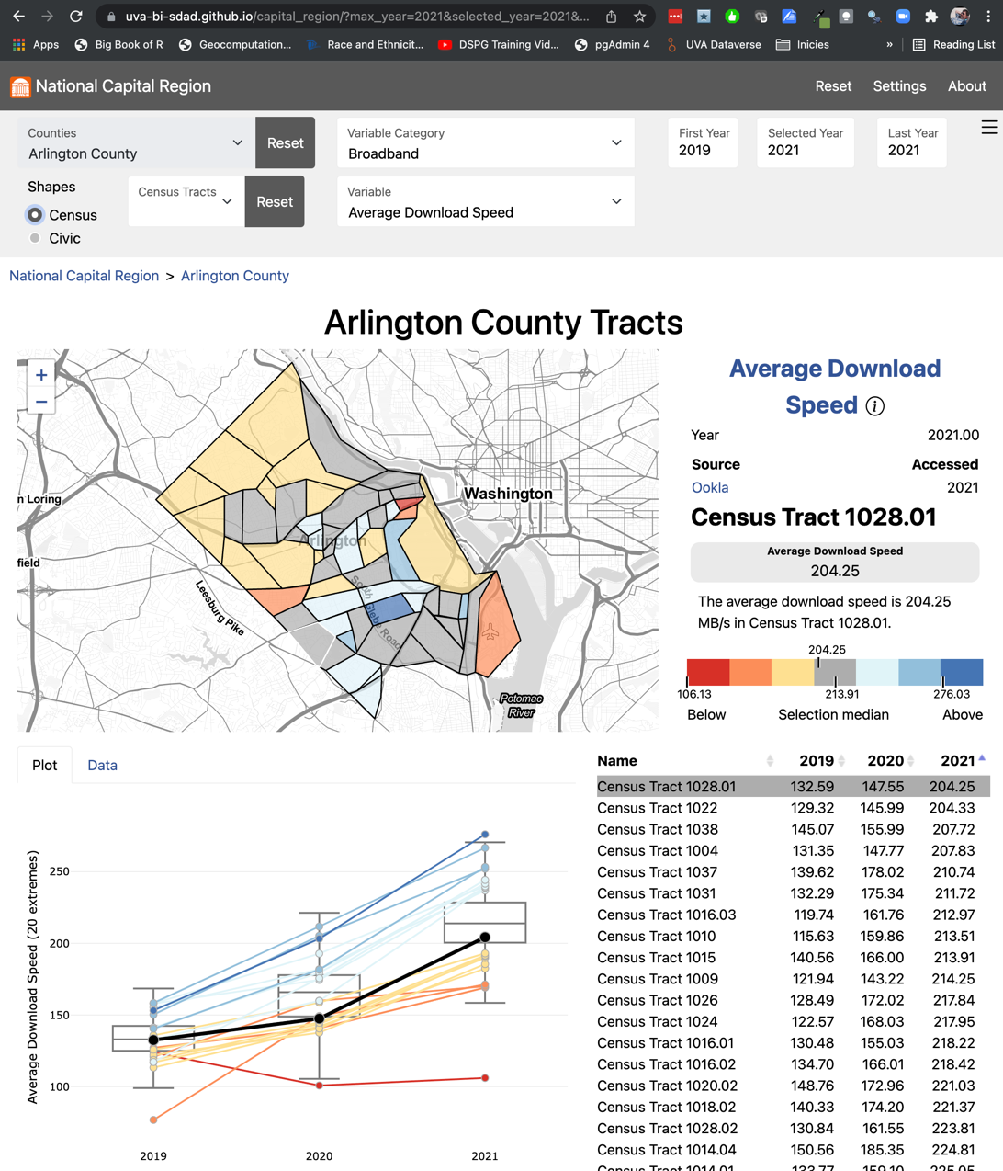
EQUITY OF ACCESS TO BROADBAND
Multiple Measures to Tell the Story
Average download speeds (from Ookla) are relatively high across Arlington with the slowest average still above 100Mb (the newer standard for “broadband”)
Ookla data only recently made available in 600-meter squares that we translated to block groups

Slide 11
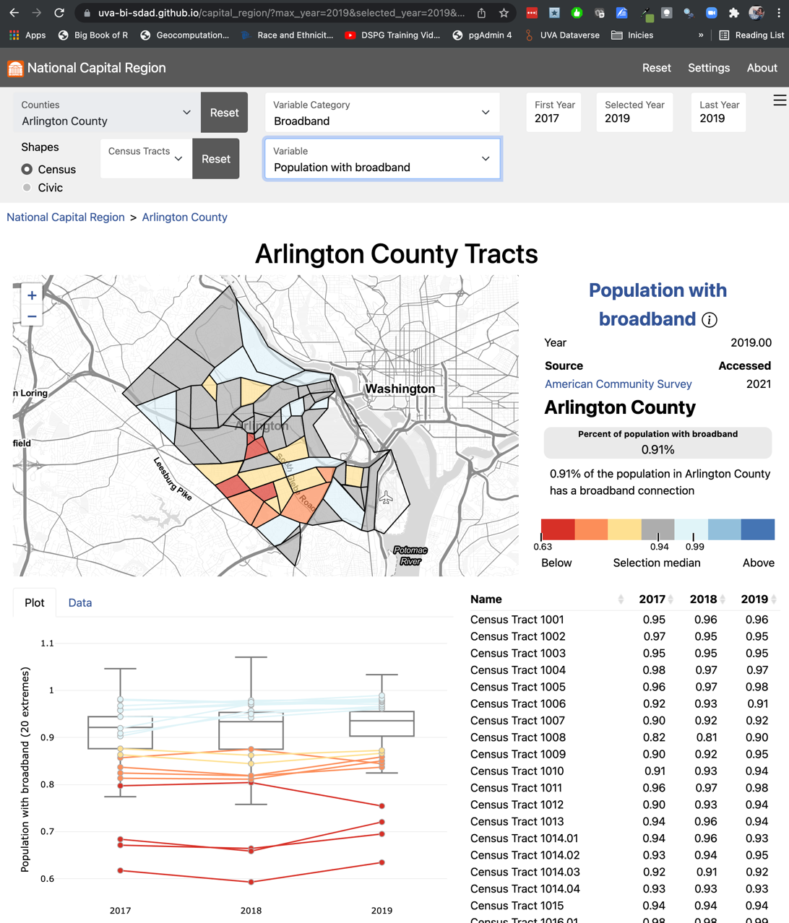
EQUITY OF ACCESS TO BROADBAND
Multiple Measures to Tell the Story
However, specific areas can be identified that have a significantly lower level of broadband adoption the the rest of Arlington

Slide 12
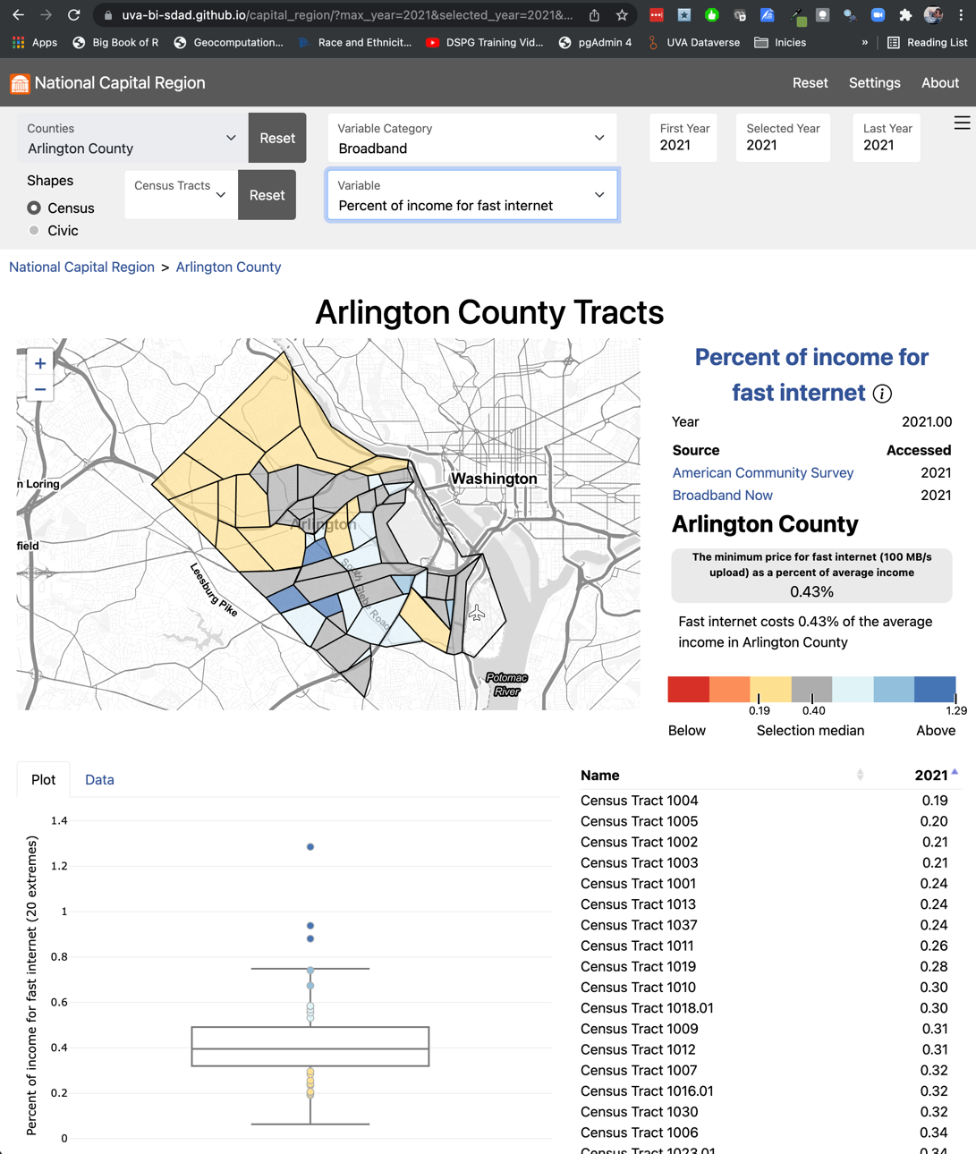
EQUITY OF ACCESS TO BROADBAND
Multiple Measures to Tell the Story
Calculated % or household income vs cost of 100Mb/s in every block group
These areas of lowest broadband adoption appear to directly correlate with the areas having the highest ratio of household income to the cost of broadband, indicating an economic issue, as opposed to an issue of availability.

Slide 13
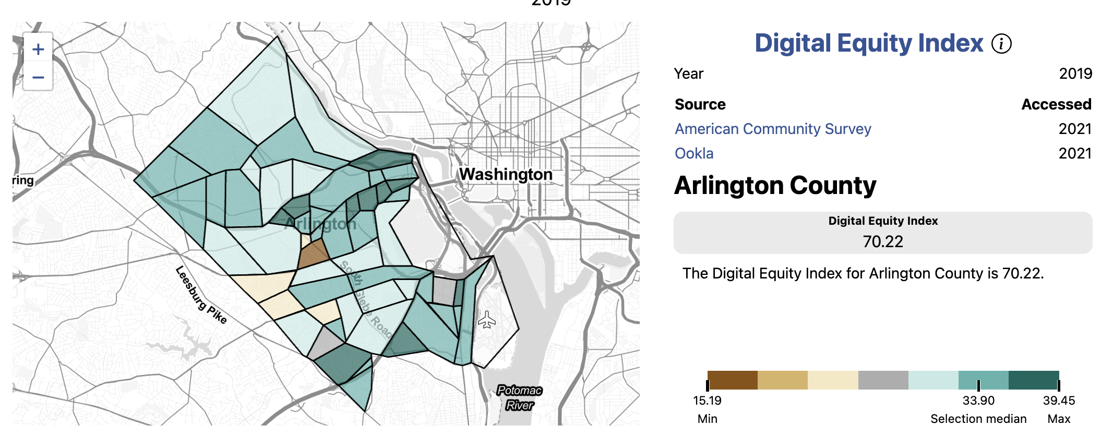
EQUITY OF ACCESS TO BROADBAND
The Digital Equity Index (DEI) Combine these with other socio-economic variables to create completely new metric
1
2
3
4

Slide 14
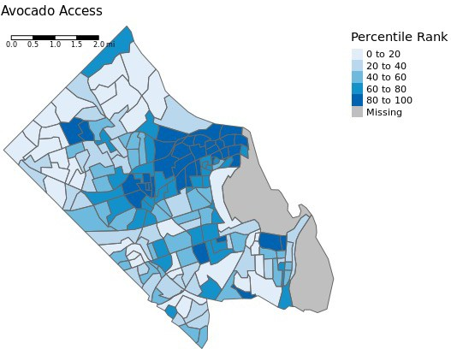
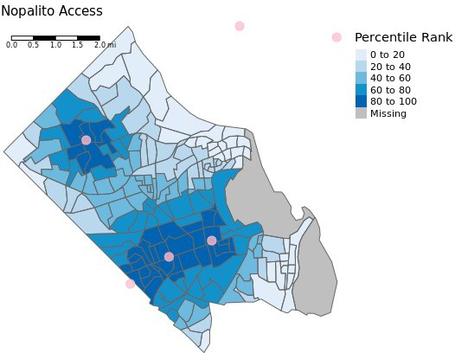
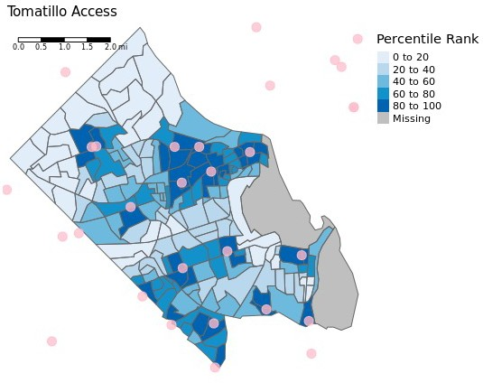
EQUITY & STABILITY OF STAPLE FOODS ACCESS
Relative access to individual food items using a gravity index Items can be combined to create culture-specific food baskets

Slide 15
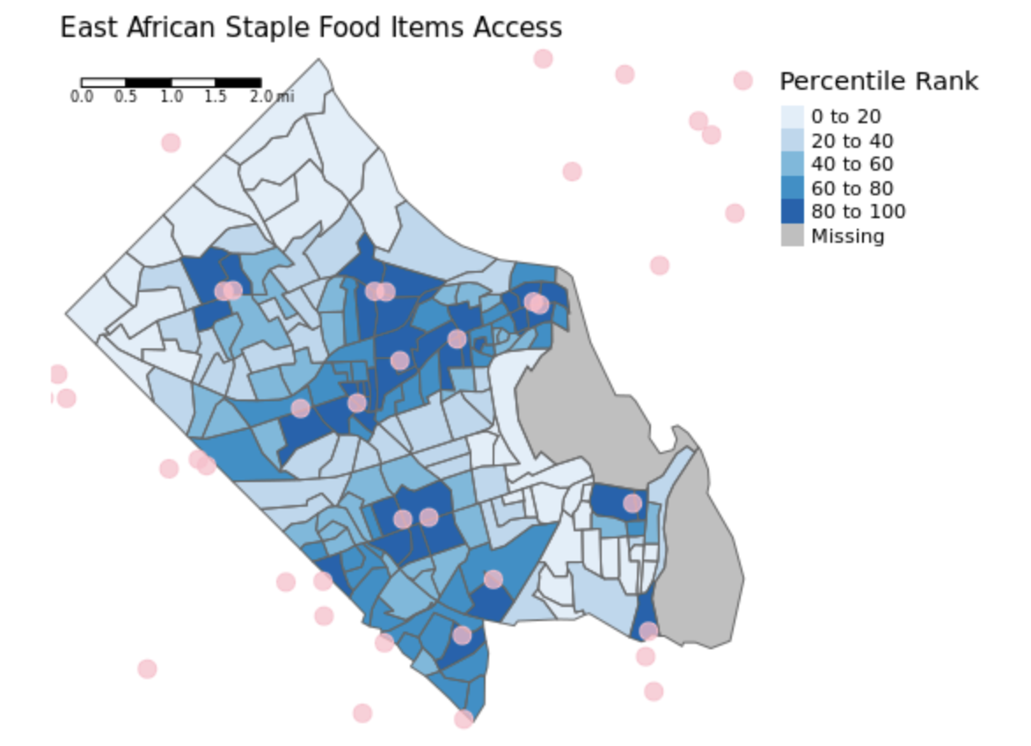
Equity & Stability of Staple Foods Access
Relative access using travel times and a gravity index

Slide 16
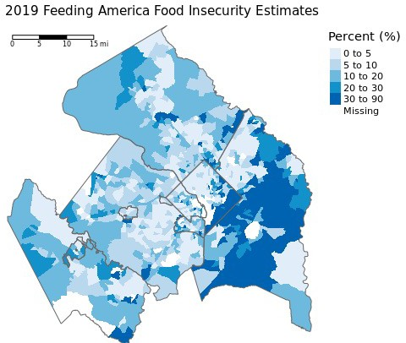
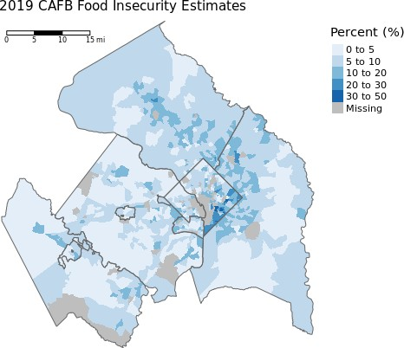
Equity & Stability of Staple Foods Access
Two Measures of Food Insecurity: Feeding America (National – adjusted to Census Tracts) and Capital Area Food Bank (Feeding America Local)

Slide 17
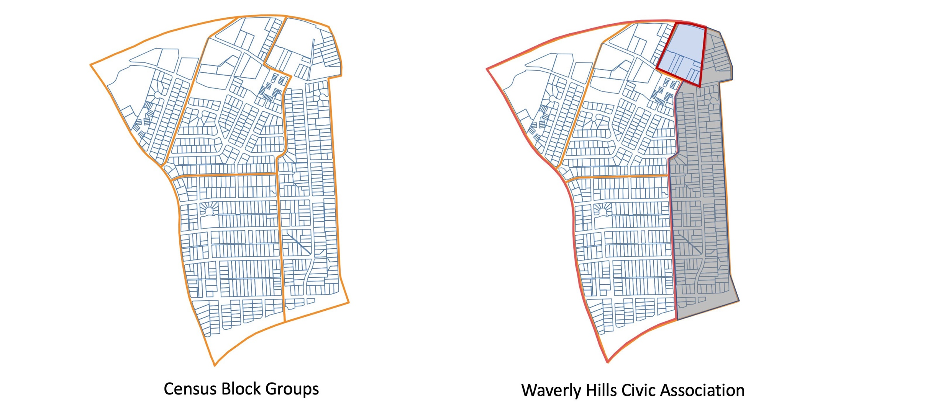
GEOGRAPHIES FOR EQUITY ANALYSIS
Translation of Census Demographics to New Geographies

Slide 18
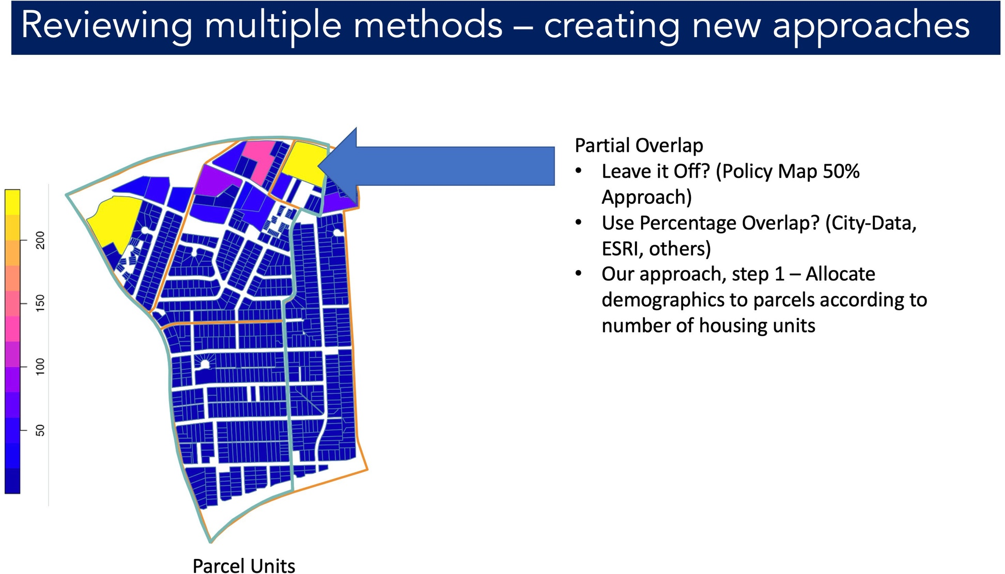
GEOGRAPHIES FOR EQUITY ANALYSIS
Translation of Census Demographics to New Geographies

Slide 19
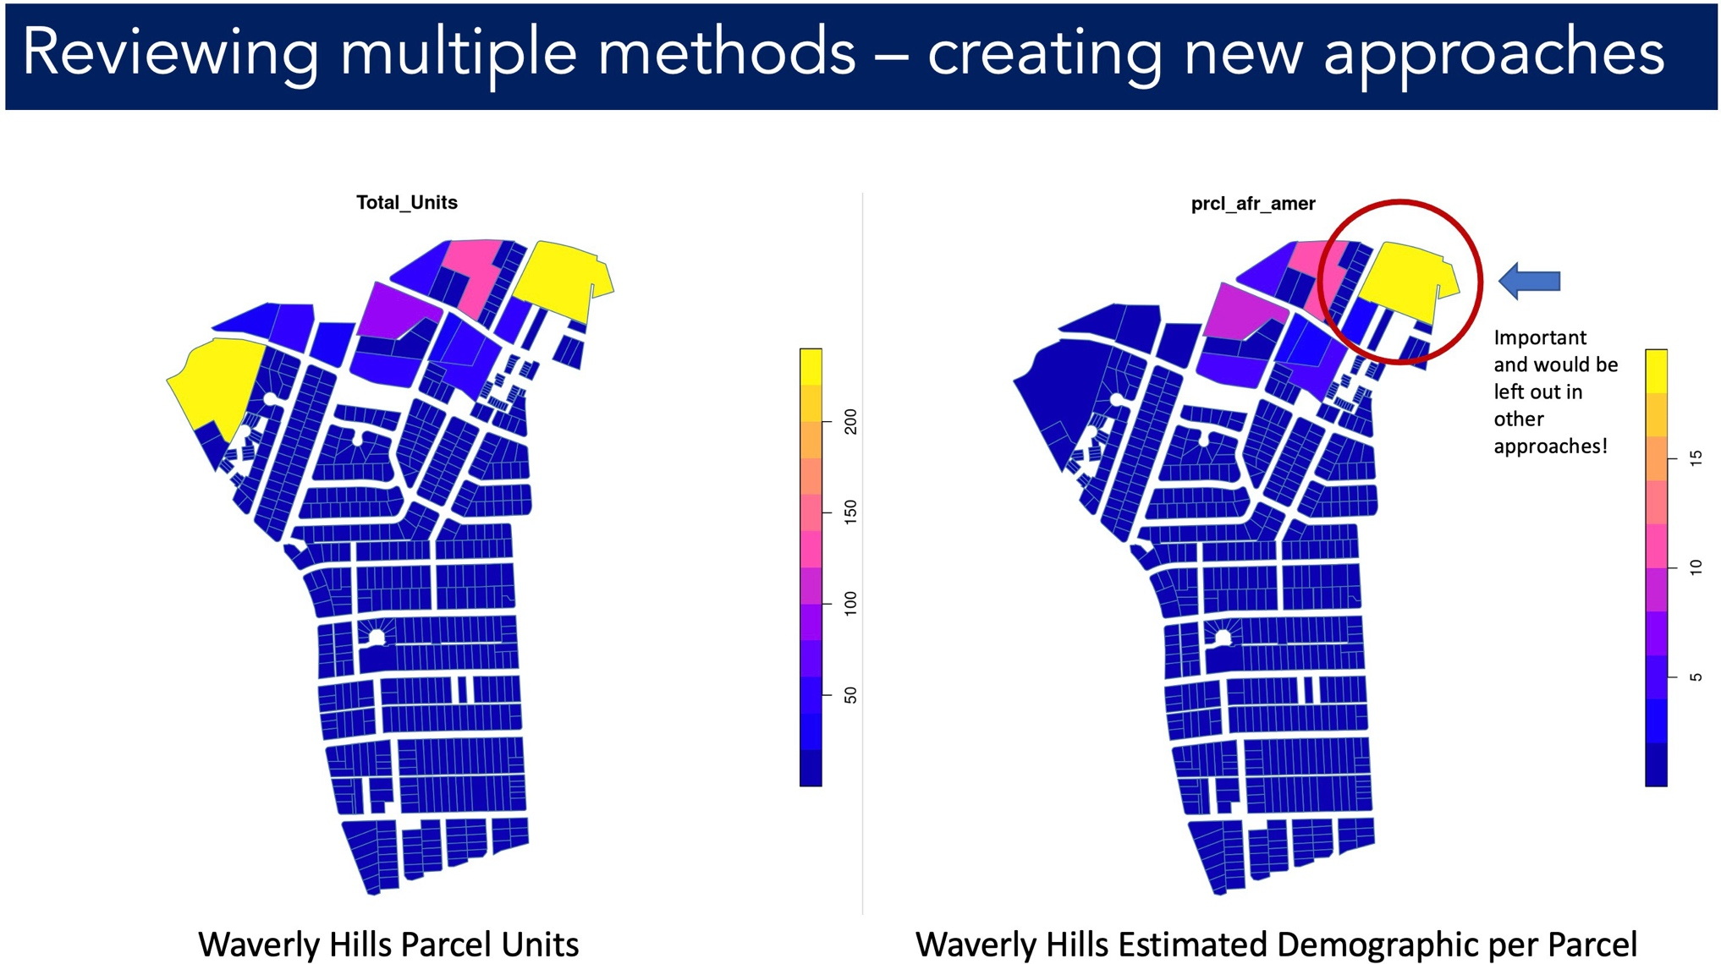
GEOGRAPHIES FOR EQUITY ANALYSIS
Translation of Census Demographics to New Geographies

Slide 20
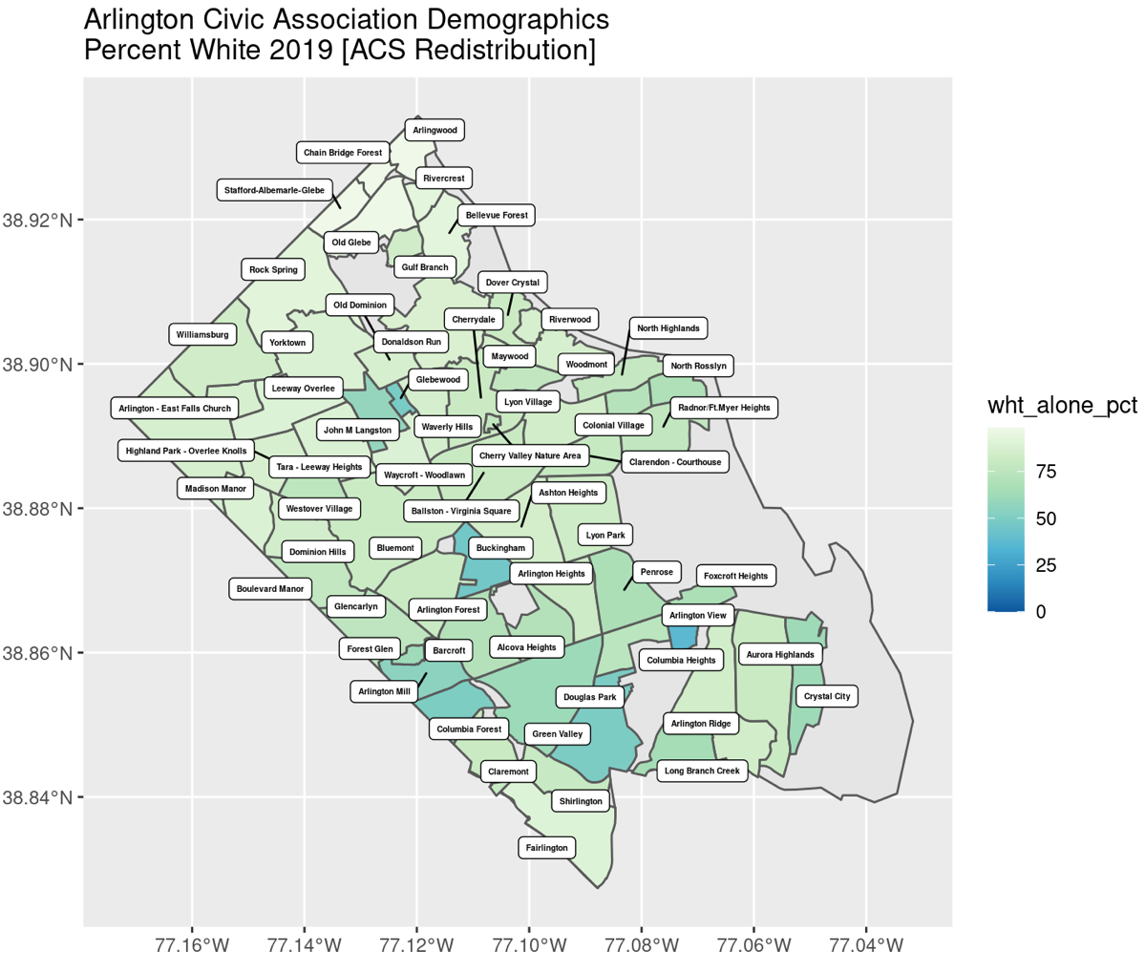
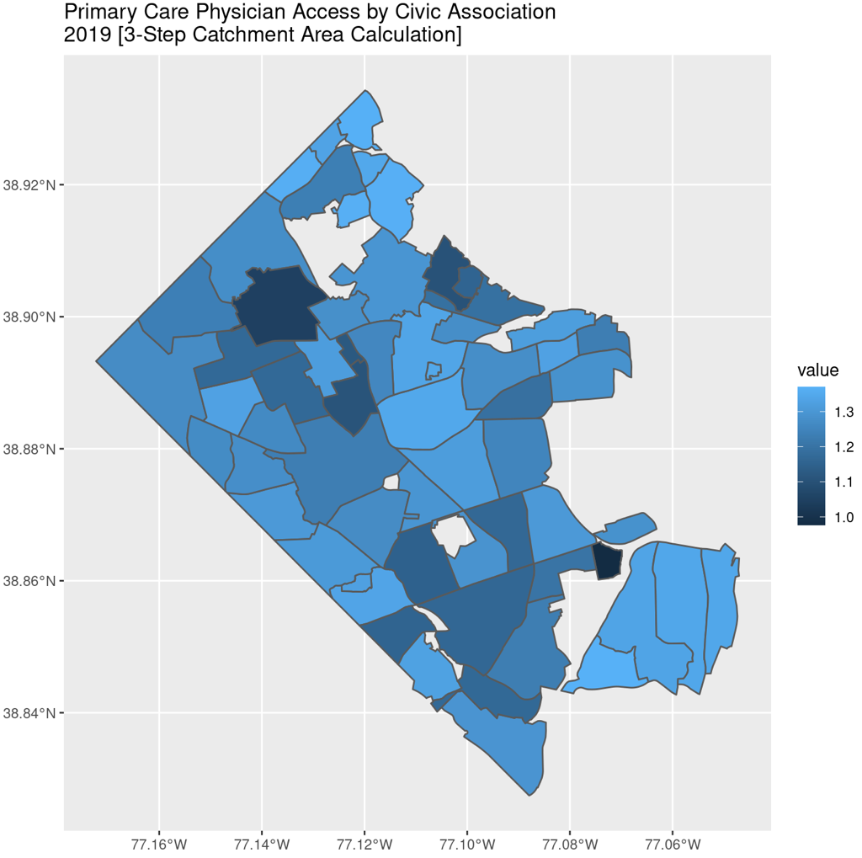
GEOGRAPHIES FOR EQUITY ANALYSIS
ACS Block Group Demographics Translated to Arlington Civic Associations
Need Civic Association Household Income Variable as Well (Coming Soon!)
Census Demographics Redistributed + Relative Primary Care Physician Access (Catchment Area) for Arlington Civic Associations

Slide 21
GEOGRAPHIES FOR EQUITY ANALYSIS
Creating data and metrics in geographies that matter locally
Translation of Census Demographics to New Geographies
Enabling Analysis by Neighborhood, rather than Census Geographies

Slide 22
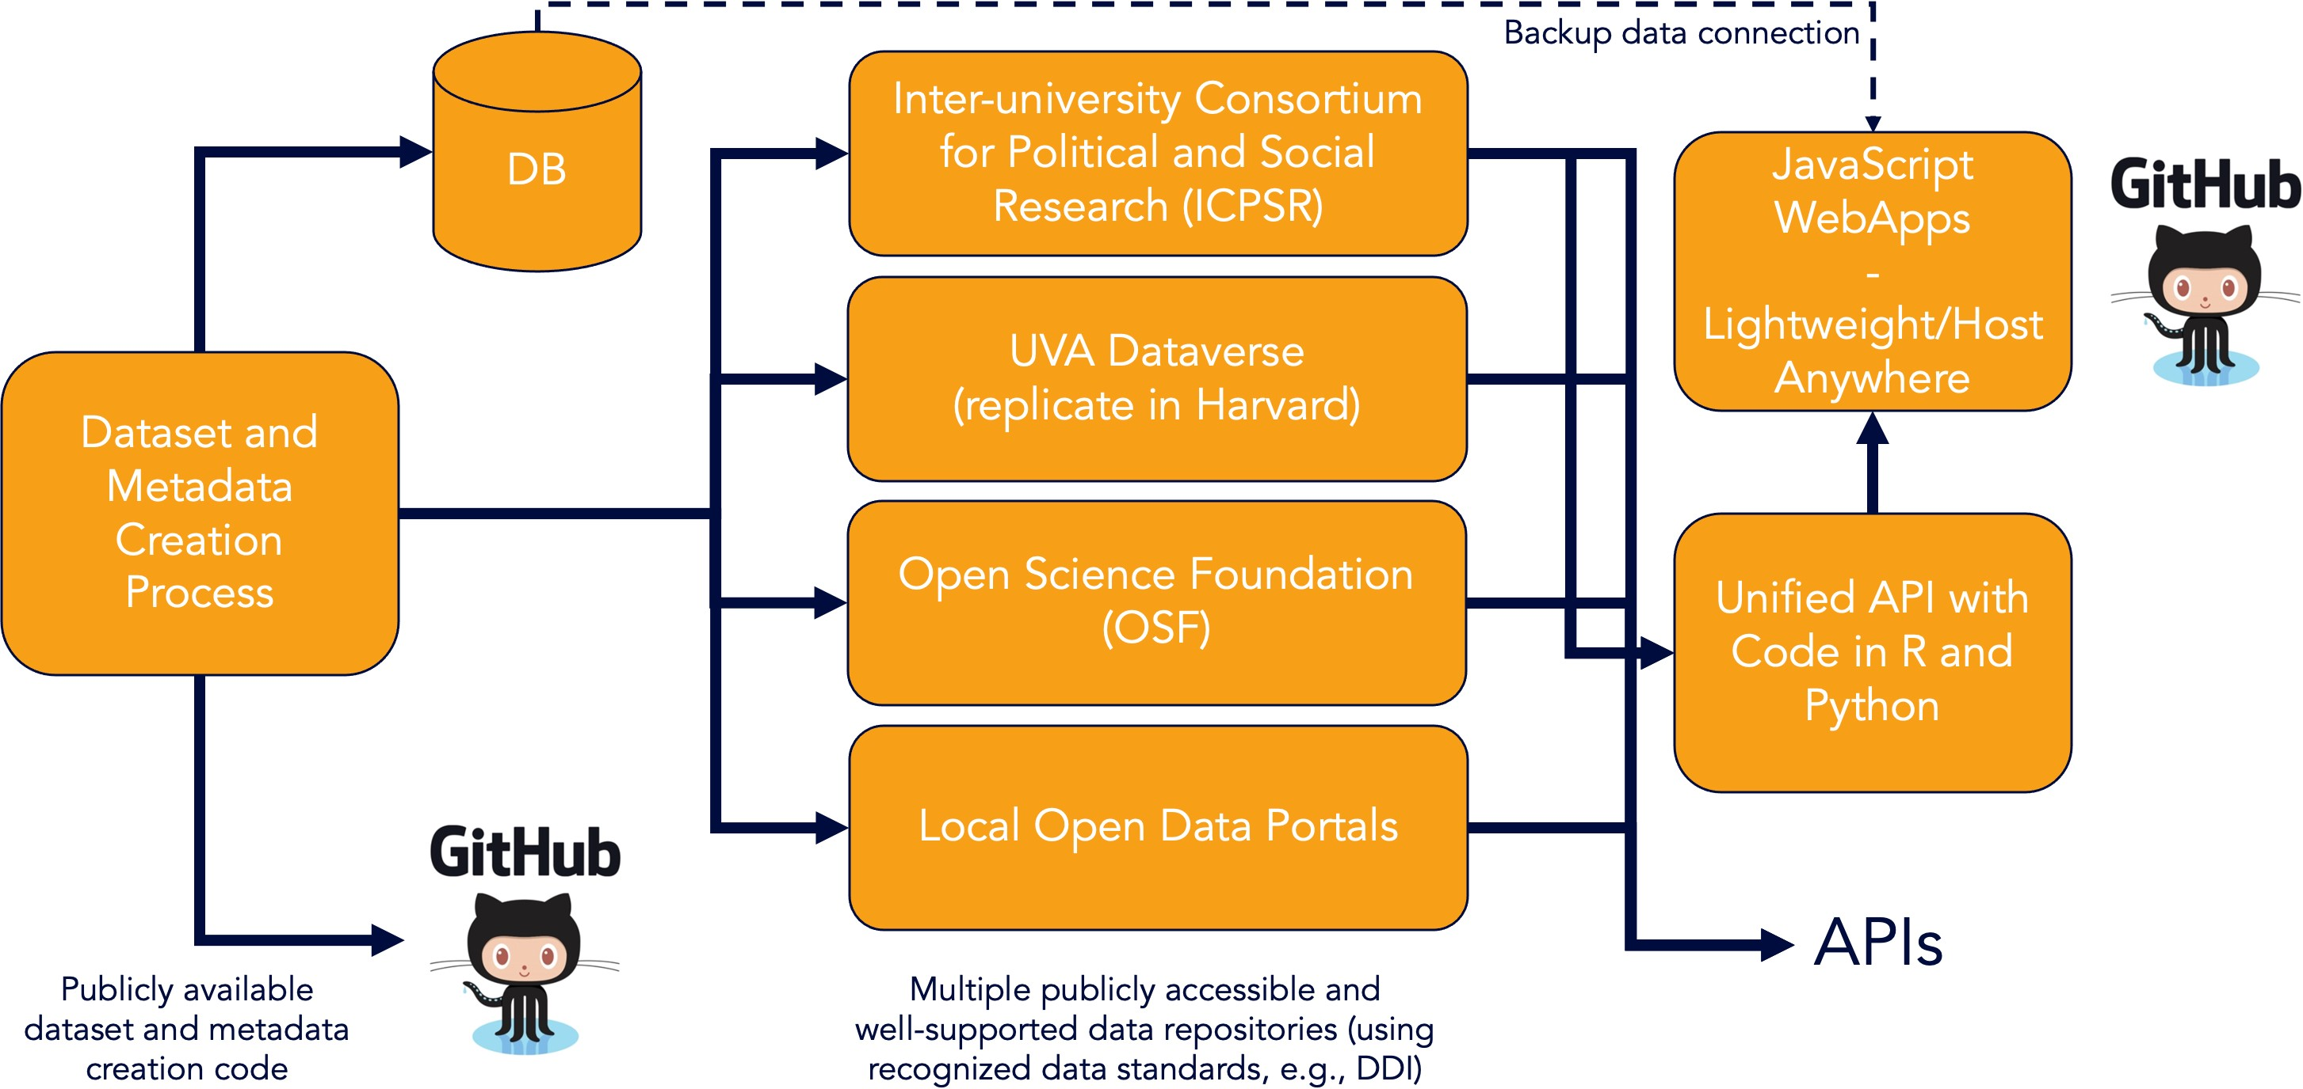
DATA COMMONS GENERALIZED ARCHITECTURE
Modular, Sustainable, Expandable

Slide 23
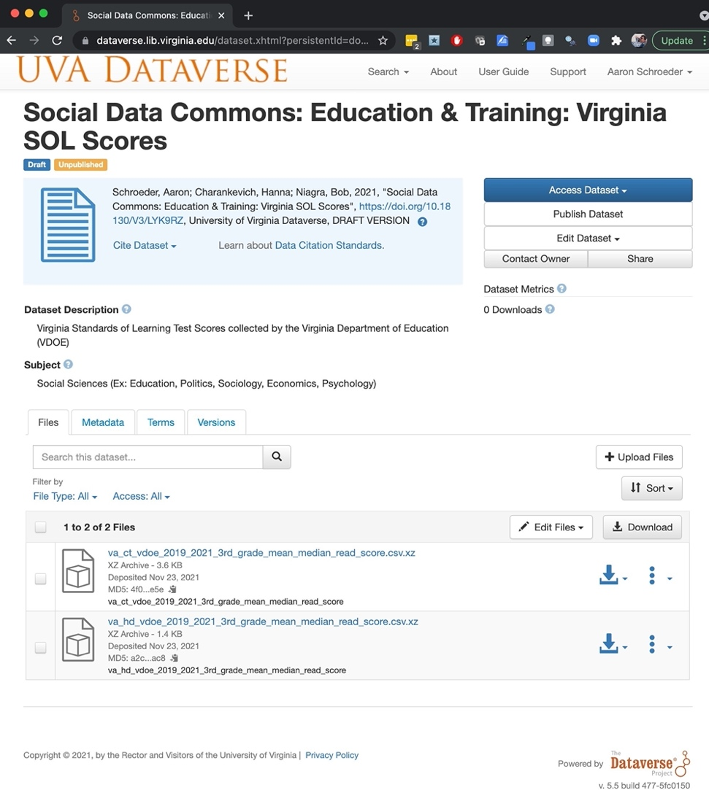
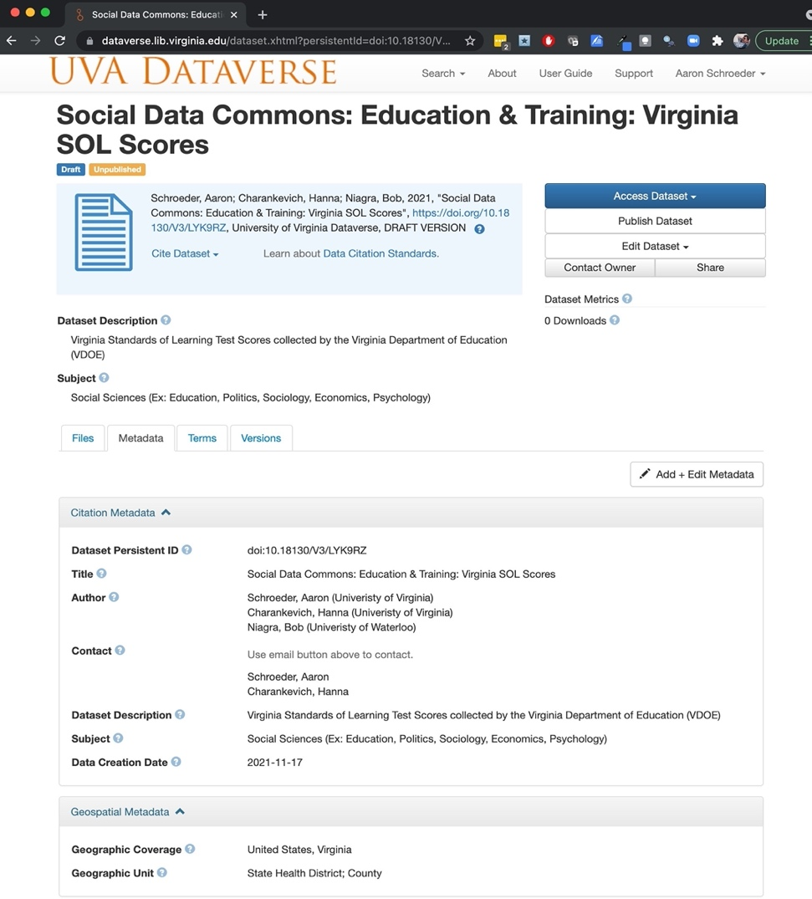
DATA COMMONS GENERALIZED ARCHITECTURE
Dataverse Storage: Leveraging free, well-supported, data and metadata storage and download

Slide 24
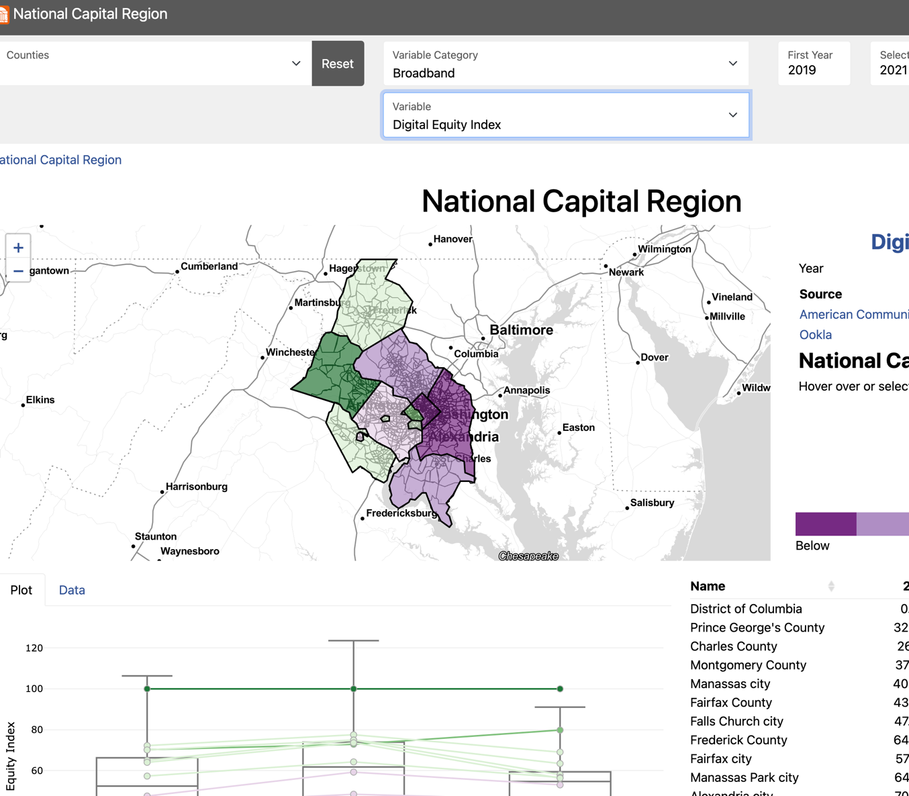
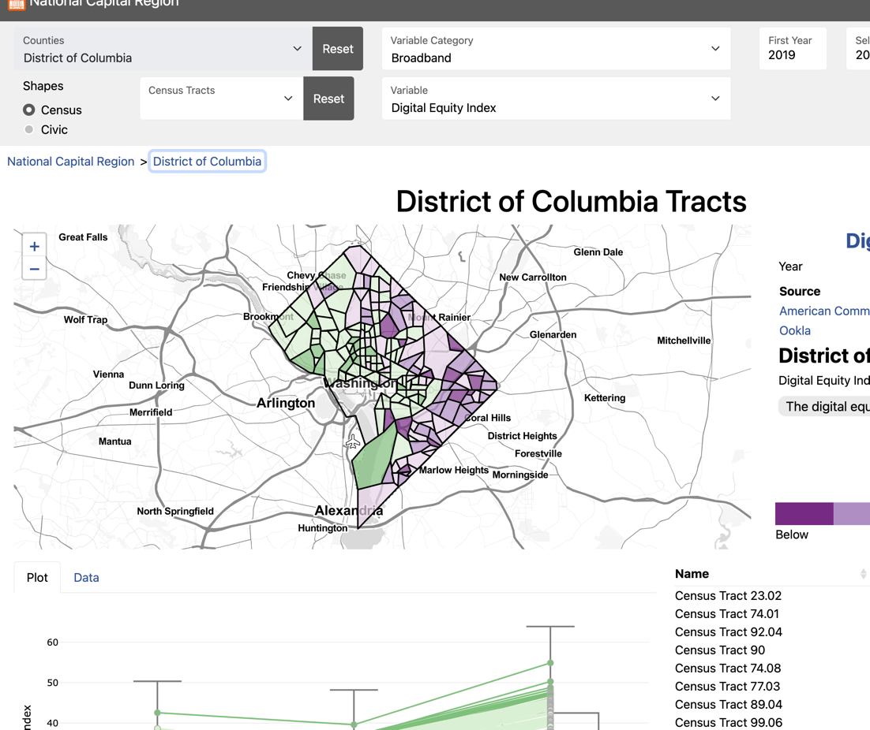
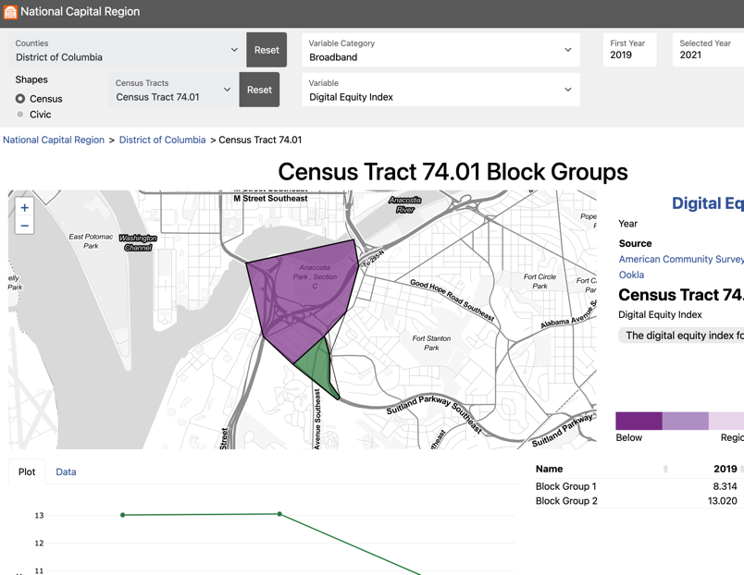
DATA COMMONS GENERALIZED ARCHITECTURE
Lightweight JavaScript WebApp, Universally Deployable: NCR Version (this project: beta): https://uva-bi-sdad.github.io/capital_region/ VDH Version (sister project: deployed, VA only): https://uva-bi-sdad.github.io/vdh_rural_health_site/

Slide 25

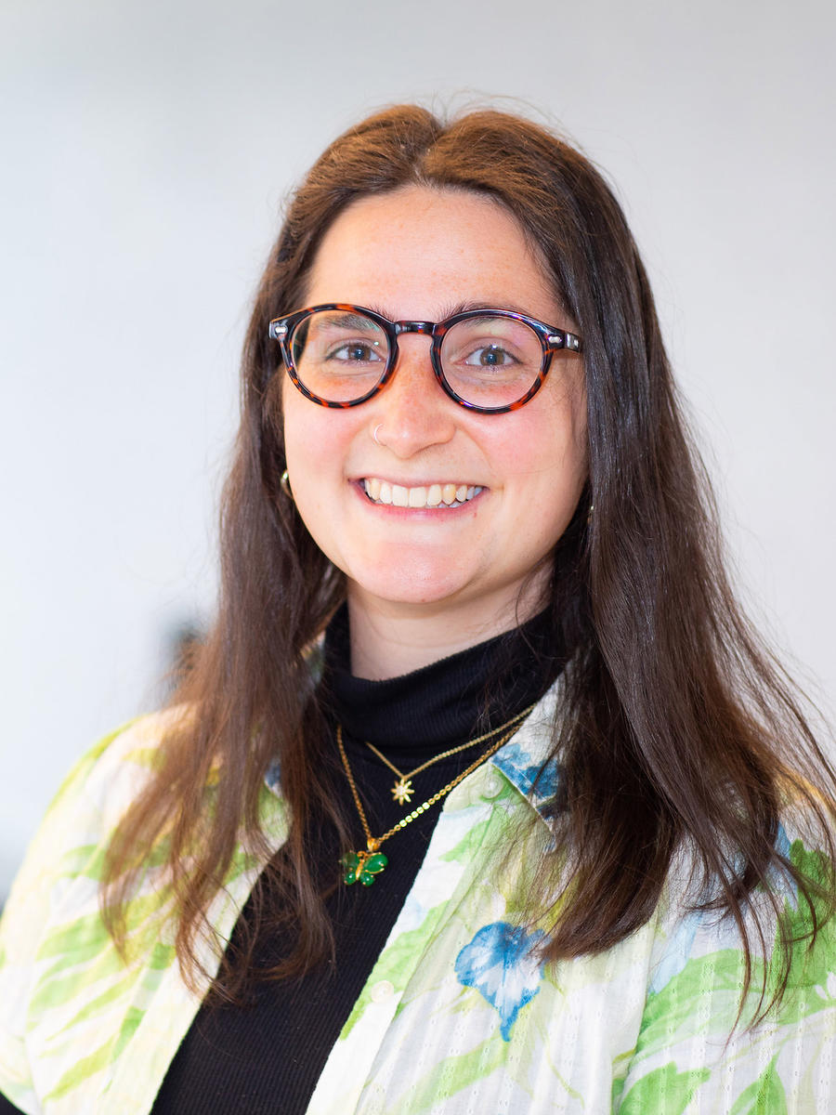




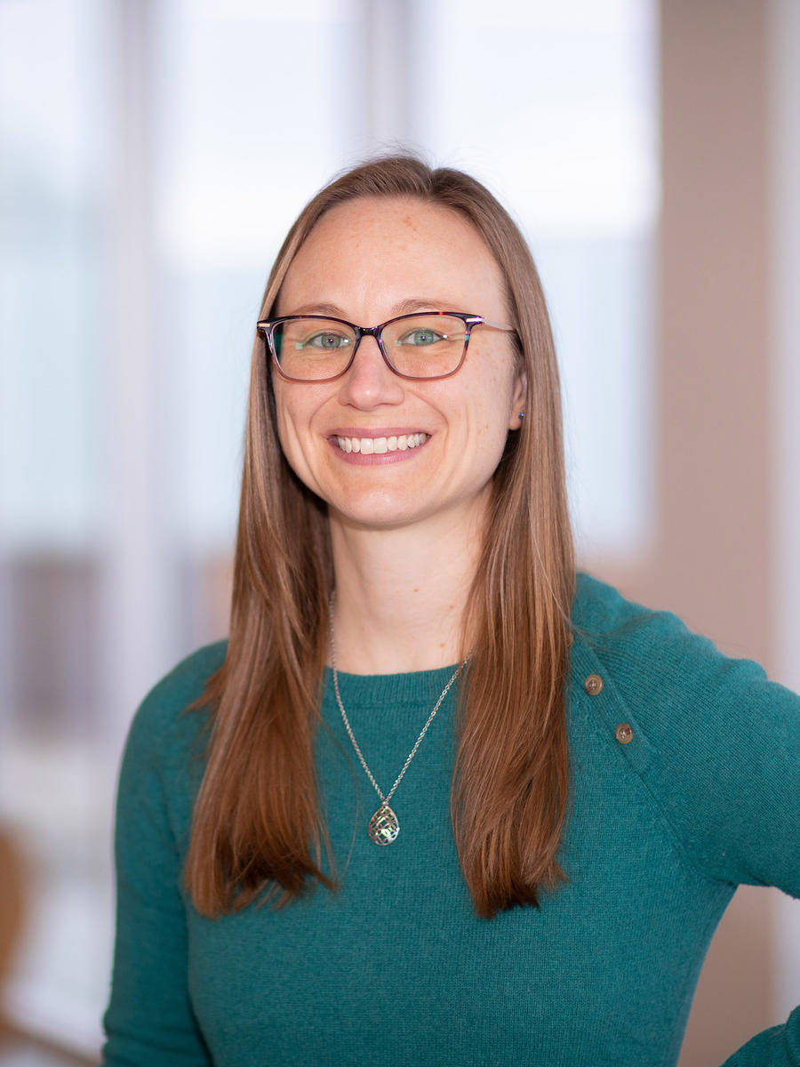
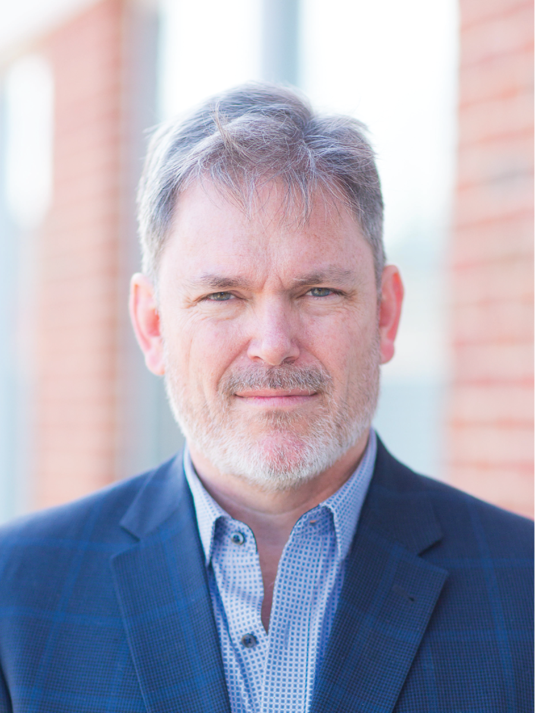

Common Data Commons People

Slide 26
Current DSPG Project Ideas/Related Skills
Refinement and expansion of Parcel-Level Demographic Model
Geospatial stuff
Disaggregation/aggregation
Statistical validation
Solidify our process of Ingestion, Evaluation, and Curation
Data engineering / GitHub Data Packages – every data area unique
Automating totally-legal data stealing / code organization
Package creation/management
Metadata management
Enhance and refine the web-based interface and APIs to the data commons projects
Front-end coding
JavaScript frameworks
API design and integration

